Slide 1
Cardiovascular-Kidney-Metabolic Health:
A 2023 Presidential Advisory From the AHA

Slide 2
Definition of Cardiovascular-Kidney-Metabolic Syndrome (CKM)
A systemic disorder characterized by pathophysiologic interactions among metabolic risk factors, chronic kidney disease, and the cardiovascular system, leading to multi-organ dysfunction and a high rate of adverse cardiovascular outcomes.
CKM syndrome includes both individuals at risk for cardiovascular disease due to the presence of metabolic risk factors and/or chronic kidney disease, and individuals with existing cardiovascular disease that is potentially related to or complicates metabolic risk factors and/or chronic kidney disease.
The increased likelihood of CKM syndrome and its adverse outcomes is further influenced by unfavorable conditions for lifestyle and self-care resulting from policies, economics, and the environment.
Abbreviations: CKM indicates Cardiovascular-Kidney-Metabolic.
Ndumele, C.E. et al., Cardiovascular-Kidney-Metabolic Health: A Presidential Advisory From the American Heart Association. 2023. Circulation.

Slide 3
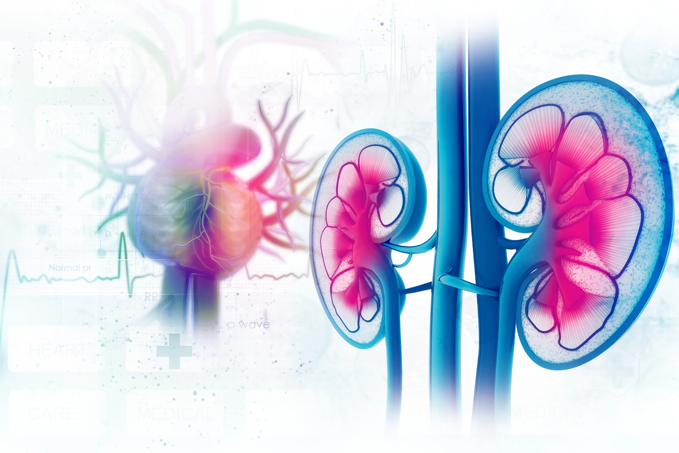
Definition of CKM Syndrome Simplified
Cardiovascular-kidney-metabolic (CKM) syndrome is a health disorder due to connections among heart disease, kidney disease, diabetes, and obesity leading to poor health outcomes.
Abbreviations: CKM indicates Cardiovascular-Kidney-Metabolic.

Slide 4
Stages of Cardiovascular-Kidney-Metabolic Syndrome
Abbreviations: Afib indicates atrial fibrillation; ASCVD, atherosclerotic cardiovascular disease; CHD, coronary heart disease; CKD, chronic kidney disease: CKM, cardiovascular-kidney-metabolic; CVD, cardiovascular disease; HF, heart failure; KDIGO, Kidney Disease Improving Global Outcomes; and PAD, peripheral artery disease.

Slide 5
Rationale for CKM Syndrome Staging
Reflects the pathophysiology of underlying CKM progression​
Importance of early detection of under-recognized clinical conditions
Each stage to represent a higher level of absolute clinical risk​
Principal focus on cardiovascular disease
The primary cause of premature mortality in relation to poor CKMH is CVD. ​
Each stage represents an opportunity for preventive intervention
The goal is to prevent the progression to the next stage
Additional focus on kidney failure​
Abbreviations: CKM indicates Cardiovascular-Kidney-Metabolic; CKMH, Cardiovascular-Kidney-Metabolic Health; and CVD, cardiovascular disease.

Slide 6
Staging Rationale
Stage 0: No CKM Syndrome Risk Factors​
Individuals without overweight/ obesity, metabolic risk factors, and CKD or subclinical/clinical CVD​
Primarily encountered in children, adolescents and young adults in the population​
Focus on primordial prevention
Abbreviations: CKD indicates chronic kidney disease; CKM, Cardiovascular-Kidney-Metabolic; and CVD, cardiovascular disease.

Slide 7
Staging Rationale
Stage 1: Excess and/or Dysfunctional Adiposity ​
Overweight/obesity, abdominal obesity and/or dysfunctional adipose tissue, without the presence of other metabolic risk factors or CKD​
Adiposity at root of most metabolic risk factors and CKD but markedly under-addressed​​
Several processes involved in the development of dysfunctional adipose tissue
Impaired glucose tolerance is a clinical manifestation​
History of gestational diabetes increases risk of developing type 2 diabetes
Abbreviations: CKM indicates Cardiovascular-Kidney-Metabolic.

Slide 8
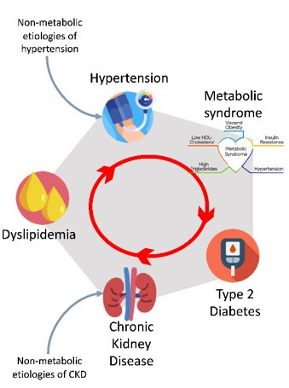
Staging Rationale
Stage 2: Metabolic Risk Factors and CKD ​
The presence of metabolic risk factors and/or CKD​
Considerable pathophysiologic interactions among conditions
Metabolic syndrome emphasizes inter-relatedness of stage 2 conditions
Hypertension
CKD
Emphasis on unique considerations for CVD prevention in the context of CKM conditions
Abbreviations: CKD indicates chronic kidney disease; CKM, Cardiovascular-Kidney-Metabolic; and CVD, cardiovascular disease.

Slide 9
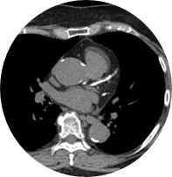
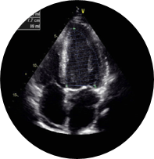
Staging Rationale
Stage 3: Subclinical CVD in CKM​
Subclinical ASCVD or subclinical HF with excess/dysfunctional adiposity, other metabolic risk factors or CKD​
Additionally includes risk equivalents of people with high predicted CVD risk and very-high risk CKD
Indicates high absolute CVD risk
Prompt preventive therapy warranted
Abbreviations: ASCVD indicates atherosclerotic cardiovascular disease; CKD, chronic kidney disease; CKM, Cardiovascular-Kidney-Metabolic; and CVD, cardiovascular disease.

Slide 10
Staging Rationale
Stage 4: Clinical CVD in CKM​ ​
Clinical CVD with excess/dysfunctional adiposity, other metabolic risk factors and/or CKD​
Stage 4a: no kidney failure
Stage 4b: kidney failure present
Management for CVD influenced by other CKM Syndrome conditions​ present
CHD
AFib
HF
Stroke
PAD
Abbreviations: Afib indicates atrial fibrillation; CHD, coronary heart disease; CKD, chronic kidney disease: CKM, cardiovascular-kidney-metabolic; CVD, cardiovascular disease; HF, heart failure; and PAD, peripheral artery disease.

Slide 11
Risk Enhancing Factors in CKMH​
Chronic inflammatory conditions
High-risk demographic groups
High burden of adverse SDOH​
Mental health disorders
Sleep disorders
History of premature menopause
History of adverse pregnancy outcomes
Polycystic ovarian syndrome​
Erectile dysfunction​
Elevated high-sensitivity C-reactive protein
Family history of kidney failure, diabetes​
Abbreviations: CKMH indicates Cardiovascular-Kidney-Metabolic Health; and SDOH, social determinants of health.

Slide 12
Screening
Rationale for CKM Syndrome Screening​
Detect asymptomatic individuals early for effective prevention
Accessible at the population level and/or routine clinical practice​
Screening test criteria
Accurate and reproducible​
Targeting where needed to “high yield” populations ​
Ongoing screening for biological markers
Screening for SDOH
Allows for stage regression
Abbreviations: CKM indicates Cardiovascular-Kidney-Metabolic.

Slide 13
Screening for CKM Syndrome
Early Life Screening​ Age <21 years
Annual screening for overweight and obesity using sex- and age-specific CDC growth charts​
Mental and behavioral health screening
Blood pressure assessment at least annually, and at every visit starting at age 3
Fasting lipid panel between ages 9-11 and again between ages 17-21
Positive family history of dyslipidemia- begin screening at age 2
Screen for glucose intolerance and monitor alanine aminotransferase​
Assign appropriate CKM Syndrome stage and begin recommended prevention
Abbreviations: CDC indicates Centers for Disease Control and Prevention; and CKM, Cardiovascular-Kidney-Metabolic.

Slide 14
Screening for CKM Syndrome
Adult Screening​ Age >=21 years
BMI and waist circumference annually
Blood pressure, HbA1c and lipid panel at stage-determined intervals
Microalbumin and creatinine measurements at stage-determined intervals
Screening for MASLD every 1-2 years as directed by guidelines
CAC measurements as directed by guidelines​
Abbreviations: BMI indicates body mass index; CAC, coronary artery calcium; CKM, Cardiovascular-Kidney-Metabolic; Hb A1C, hemoglobin a1c; and MASLD, metabolic dysfunction-associated steatotic liver disease.

Slide 15
Screening for CKM Syndrome
SDOH Screening​
Use stablished screening tools​
Financial strain
Education/literacy​
Screening tools can also assess for health behaviors impacted by SDOH
Personal safety​
Mental health​
Incorporate an existing screening tool into the clinical care workflow and EHR​
Abbreviations: CKM indicates Cardiovascular-Kidney-Metabolic; and SDOH, social determinants of health.

Slide 16
CKM Syndrome Prevention and Management
Interdisciplinary Care Models
Value-based care
Involvement of interdisciplinary care team when any two of the following are present: CKD, diabetes, and subclinical/clinical CVD
Interdisciplinary team
Primary care
Subspecialists
Pharmacy
Volume-based care
Targeted referrals to subspecialists.
Nephrology
Endocrinology
Cardiology
CKM coordinator assistance with patient navigation across multiple subspecialists
Utilization of telemedicine to see subspecialists as needed
Nursing
CKM coordinator
Development of clinical protocols based on guidelines.
Interdisciplinary team meets at regular intervals to discuss plan of care
Abbreviations: CKM indicates Cardiovascular-Kidney-Metabolic.

Slide 17
CKM Syndrome Prevention and Management
Addressing SDOH in Care Model​
Integration of SDOH assessments into clinical care workflow and EHR​
Systematic screening for SDOH using validated tools​
Incorporation of community health workers into integrated care team for patient support and navigation
Leveraging existing community resources and community programs​
Abbreviations: CKM indicates Cardiovascular-Kidney-Metabolic; and SDOH, social determinants of health.

Slide 18
CKM Syndrome Management Stages 1-3
Abbreviations: ACEi indicates angiotensin-converting-enzyme inhibitors; ARB, angiotensin II receptor blockers; ARNi, angiotensin receptor/neprilysin inhibitors; ASCVD, atherosclerotic cardiovascular disease; BP, blood pressure; BMI, body mass index; CHD, coronary heart disease; CHW, community health worker; CKD, chronic kidney disease; CKM, cardiovascular-kidney-metabolic; CVD, cardiovascular disease; DKD, diabetic kidney disease; DM, diabetes mellitus; EF, ejection fraction; GLP-1RA, GLP-1 receptor agonist; HbA1c, hemoglobin A1c; HF, heart failure; IGT, impaired glucose tolerance; MetS, metabolic syndrome; P2Y12i, P2Y12 inhibitors; SDOH, social determinants of health; SGLT2i, sodium-glucose transport protein 2 inhibitors; STOP, Strategies to Overcome and Prevent; and UACR, urine albumin-creatinine ratio.

Slide 19
CKM Syndrome Management Stage 4
Abbreviations: ACEi indicates angiotensin-converting-enzyme inhibitors; ARB, angiotensin II receptor blockers; ARNi, angiotensin receptor/neprilysin inhibitors; ASCVD, atherosclerotic cardiovascular disease; BP, blood pressure; BMI, body mass index; CHD, coronary heart disease; CHW, community health worker; CKD, chronic kidney disease; CKM, cardiovascular-kidney-metabolic; CVD, cardiovascular disease; DKD, diabetic kidney disease; DM, diabetes mellitus; EF, ejection fraction; GDMT, guideline-directed medical therapy; GLP-1RA, GLP-1 receptor agonist; HbA1c, hemoglobin A1c; HF, heart failure; IGT, impaired glucose tolerance; LDL, low-density lipoprotein; MetS, metabolic syndrome; P2Y12i, P2Y12 inhibitors; SDOH, social determinants of health; SGLT2i, sodium-glucose transport protein 2 inhibitors; STOP, Strategies to Overcome and Prevent; and UACR, urine albumin-creatinine ratio.

Slide 20
Cardiovascular-Kidney-Metabolic Syndrome Call to Action
Supporting Healthy Lifestyle in Communities
Patient-Centered Implementation Focus
Consideration of SDOH
Implementation Within and Across Health Centers
Social Determinants of Health
Enhanced Obesity Management
Addressing Research Gaps
Interdisciplinary
Care
CKM
Education
Abbreviations: CKM indicates Cardiovascular-Kidney-Metabolic; and SDOH, social determinants of health.

Slide 21
Cardiovascular-Kidney-Metabolic Syndrome Call to Action
Consideration of SDOH
Upfront priority for screening of SDOH to guide approaches to care​
Integration of SDOH assessments into clinical workflow and electronic health records ​
Incorporation of individuals into the care team to address access, navigation, and social barriers​
Leveraging community resources for needs based on SDOH screening​
Need for more data on the impact of SDOH screening and addressing social needs on CKM risk factors and outcomes​
Abbreviations: CKM indicates Cardiovascular-Kidney-Metabolic; and SDOH, social determinants of health.

Slide 22
Cardiovascular-Kidney-Metabolic Syndrome Call to Action
Interdisciplinary Care
Interdisciplinary care for individuals with a confluence of CKM factors. Two complementary approaches:​
Value-based care model: Use of CKM coordinator and interdisciplinary team to provide remote guidance regarding CKM care​
Volume-based care model: targeted referrals of high-risk patients to Cardiology, Endocrinology, Nephrology​
May rely more on value-based care model in health centers/regions with a low density of subspecialists​
Appropriate reimbursement models and infrastructure needed
Abbreviations: CKM indicates Cardiovascular-Kidney-Metabolic..

Slide 23
Cardiovascular-Kidney-Metabolic Syndrome Call to Action
Access to Pharmacotherapies
Incorporate representation of health systems, payors, patients, and caregivers into policy change advocacy measures​
Utilization of pharmacists and social workers on the interdisciplinary CKM team to facilitate access ​
Advocacy for policy level changes to ensure access​
Abbreviations: CKM indicates Cardiovascular-Kidney-Metabolic..

Slide 24
Cardiovascular-Kidney-Metabolic Syndrome Call to Action
Addressing Research Gaps
Need to address key gaps in CKM knowledge, screening, prevention, management and implementation of care models through intensified research efforts​
Emphasis on interdisciplinary and cross-specialty investigative approaches that reflect the interconnectedness inherent to CKMH​
Envision the possibility for research investments related to CKMH, in addition to research fellowships for trainees​
Abbreviations: CKM indicates Cardiovascular-Kidney-Metabolic; and CKMH, Cardiovascular-Kidney-Metabolic health.

Slide 25
Cardiovascular-Kidney-Metabolic Syndrome Call to Action
CKM Education
Prioritize education for health care professionals and community members regarding CKMH ​
Underlying science and inter-connectedness of CKMH​
Definition of CKM syndrome​
CKMH staging​
Prediction of outcomes in CKM​
Approaches to CKM prevention and management ​
Abbreviations: CKM indicates Cardiovascular-Kidney-Metabolic; and CKMH, Cardiovascular-Kidney-Metabolic health.

Slide 26
Cardiovascular-Kidney-Metabolic Syndrome Call to Action
Enhanced Obesity Management
Enhance education about approaches to obesity ​
Providing toolkit for addressing obesity in clinical encounters​
Emphasis on integrated teams to support a patient-centered approach to weight loss:​
Obesity medicine, metabolic surgery, dietician, pharmacy, mental health, community health workers/care manager​
Need to advocate for better access to obesity pharmacotherapies and better reimbursement for obesity management in health centers​

Slide 27
Cardiovascular-Kidney-Metabolic Syndrome Call to Action
Implementation within and across Health Centers
Informed by the AHA’s CKMH initiative, validated CKMH measures and center-specific performance across registry-based data
Patient-centric AHA CKMH certification program, allowing for the designation of an AHA Center for CKMH Excellence for institutions that meet criteria for optimal implementation of specified CKMH metrics.​
CKMH certification could activate implementation of key CKMH quality improvement metrics and hospital certification programs not only across GWTG hospitals in the US, but also in 13 other countries globally where the AHA is currently engaged, allowing for a scaled up global impact.​
Abbreviations: AHA indicates American Heart Association; and CKMH, Cardiovascular-Kidney-Metabolic health.

Slide 28
Cardiovascular-Kidney-Metabolic Syndrome Call to Action
Supporting Healthy Lifestyle in Communities
Critical need to support the achievement of ideal cardiovascular health, particularly healthy lifestyle, in community settings​
Will involve multi-level partnerships between AHA and outside stakeholders​
Emphasis on strategies to enhance cardiovascular health across the life course and across diverse communities​

Slide 29
Cardiovascular-Kidney-Metabolic Syndrome
CKD Screening
Monitor UACR
Heart Failure
High Blood Pressure
ASCVD
Metabolic Dyslipidemia
Coordinated and Affordable Care
Patient-Centered Implementation Focus
Elevated BMI Obesity
Neighborhood and Built Environment
Blood Glucose Insulin Monitoring
Social Determinants of Health
Abbreviations: ASCVD indicates atherosclerotic cardiovascular disease; BMI, body mass index; CKD, chronic kidney disease; and UACR, urine albumin-creatinine ratio.

